Slide 1
Introduction to Programming
Part 1
Barb Ericson
Georgia Institute of Technology
Aug 2005

Slide 2
Learning Goals
Understand at a conceptual level
  What is a computer?
  What is a program?
  The evolution of programming
  What is Java?
  Why don’t we program in English?

Slide 3
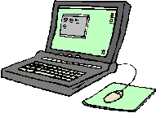
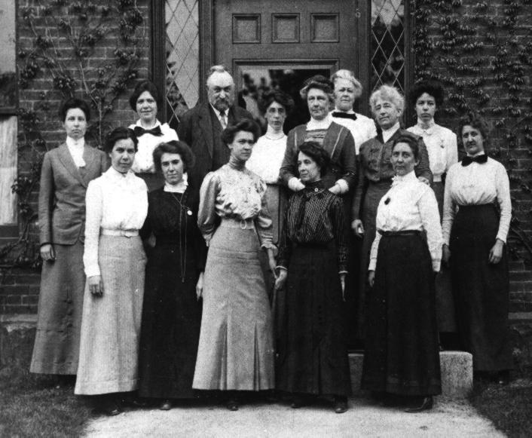
What is a Computer?
A device that performs high-speed mathematical and/or logical operations or that assembles, stores, correlates, or otherwise processes information.
The first computers were people
  who did computations
Notes:
The picture shows the Harvard Computers which were women who did astronomical computations at Harvard University. See http://cannon.sfsu.edu/~gmarcy/cswa/history/pick.html
See http://cannon.sfsu.edu/~gmarcy/cswa/history/computers.html
See http://www.maxmon.com/history.htm and http://ei.cs.vt.edu/~history/TMTCTW.html for some of the history of computers
See http://www.softlord.com/comp/ for a history of computers.
See http://www.cs.colorado.edu/~lindsay/talk/index.html for some computers you may not be familiar with. Also see http://www.computer50.org/kgill/transistor/trans.html.

Slide 4
Why Do Computers Keep Getting Cheaper?
The number of transistors (a major component of the brain of a computer) at the same price doubles every 18 months
  making computers faster, smaller, and cheaper over time
This notion is know as Moore’s Law
  For Gordon Moore, a founder of Intel
This “Law” has held true for decades
  And is predicted to hold true at least one more
Notes:
See http://www.intel.com/education/transworks/ for more information on transistors.
See http://www.intel.com/research/silicon/mooreslaw.htm for more information on Moore’s Law.
See http://www.cs.colorado.edu/~lindsay/talk/transistor.html for a picture of the first transistor.
See http://ourworld.compuserve.com/homepages/Andrew_Wylie/history.htm for a history of transistors.

Slide 5
What are Computers Good At?
Doing calculations and comparisons
Producing the same answer every time
  Like calculating the sum of hundreds of numbers
    Computer don’t tire of tedious tasks
Storing information
  They don’t forget information
Looking up information quickly
  Search through a phone book to find the customer name for a phone number
Notes:
Notice that these are things that people aren’t great at.

Slide 6

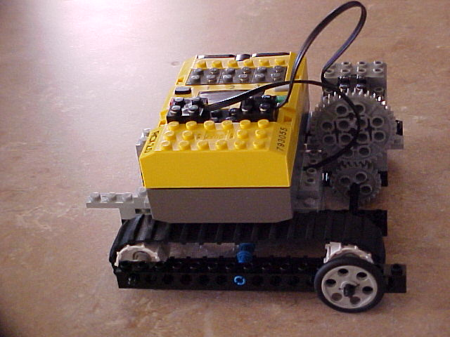
What is Programming?
Creating detailed instructions that a computer can execute to accomplish some task.
  Like writing a recipe for your favorite dish
  Or giving someone directions to your house
  Or making a robot do what you want
Notes:
Put your favorite recipe on the coweb (http://coweb.cc.gatech.edu/ice-gt/). See if someone else can follow the directions.
Write down the directions to your house. See if someone else can follow them to find it.
Use LEGO Mindstorms RIS to build a robot and use Robocode to program it.

Slide 7
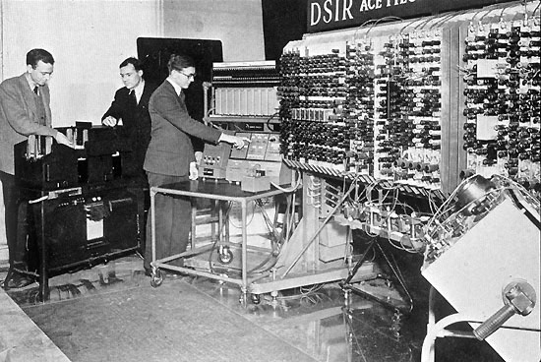
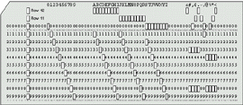
Early Programming
Early computers required the programmer to set switches and move wires
  Which represented a series of 1’s and 0’s
Later computers were programmed using punched cards
Notes:
The punch cards had first been used to program looms for weaving see http://www.maxmon.com/punch1.htm.
For a short history of programming see http://www.princeton.edu/~ferguson/adw/programming_languages.shtml.

Slide 8
Language Evolution
Early languages were based on how to do instructions on each machine
  1’s and 0’s to add, subtract, read, store, etc
Assembler allowed you to write programs using names for instructions and memory
  But still translated into machine language
Higher-level languages
  Are compiled into machine language or virtual machine language (Java)

Slide 9
Java
Developed at Sun in the early 1990s
  Invented by James Gosling
Similar to C++ in syntax but easier to use
  Less likely to crash
Cross-platform, object-oriented language
Used in business, science, and education
One of the fastest adopted technologies of all time
Notes:
For more information on Java see http://www.cs.iastate.edu/~leavens/ComS541Fall97/hw-pages/history/Java.html.
See http://java.sun.com/docs/books/tutorial/getStarted/application/ for a sample program.
See http://java.sun.com/ for Sun’s Java web site. It has documentation and tutorials.
See http://java.sun.com/people/jag/ for more on James Gosling.

Slide 10
Which Language?
All high-level languages are eventually translated into machine language
You can write the same program in any language
  The computer doesn’t care what high-level language you use
The language matters to the programmer
  How long does it take to write the program?
  How hard is it to change the program?
  How long does it take to execute?

Slide 11


Why Don’t We Just Use English?
English is good for communication between two intelligent humans
  Even then we sometimes don’t understand
Computers are very stupid
  They basically know how to add, compare, store, and load
  Programs are very detailed instructions
    Everything must be precise and unambiguous

Slide 12

Programming Exercise
Write down instructions for how to make a sandwich or play a game
Have another group read the directions and do the actions
  stop anytime anything isn’t clear and ask for clarification
Notes:
Try doing other direction exercises. Write down directions for how to get to a classroom in the school. Write down directions for how to use a computer program.

Slide 13
Summary
Computers perform calculations and comparisons
A program is a series of instructions to a computer
Programming has changed from moving wires to writing textual programs that can be stored and executed several times
Java is a high level popular programming language

